Slide 1
The Fetch-Execute Cycle
LO:
Prep Check
xx

Slide 2
The Fetch-Execute Cycle
LO:
Specification Point
3.7.2.1 The meaning of the stored program concept
3.7.3.1 The processor and its components
3.7.3.6 Interrupts (A Level only)

Slide 3
The Fetch-Execute Cycle
LO:
Revision
Instruction Set
Machine Code
Binary Word
Advantage of wider Address Bus
Advantage of wider Data bus
What is sent over the control bus?

Slide 4
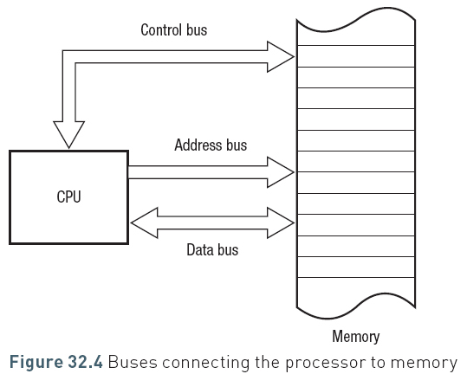
The Fetch-Execute Cycle
LO:
Stored Program concept
A program is a series of instructions that the processor will carry out
Programs also require the data on which these instructions will be carried out.
A program is loaded into main memory when it is run.
The instructions and data that comprise a program are both stored in main memory and must both pass through the same bus (the data bus) in and out of memory.

Slide 5
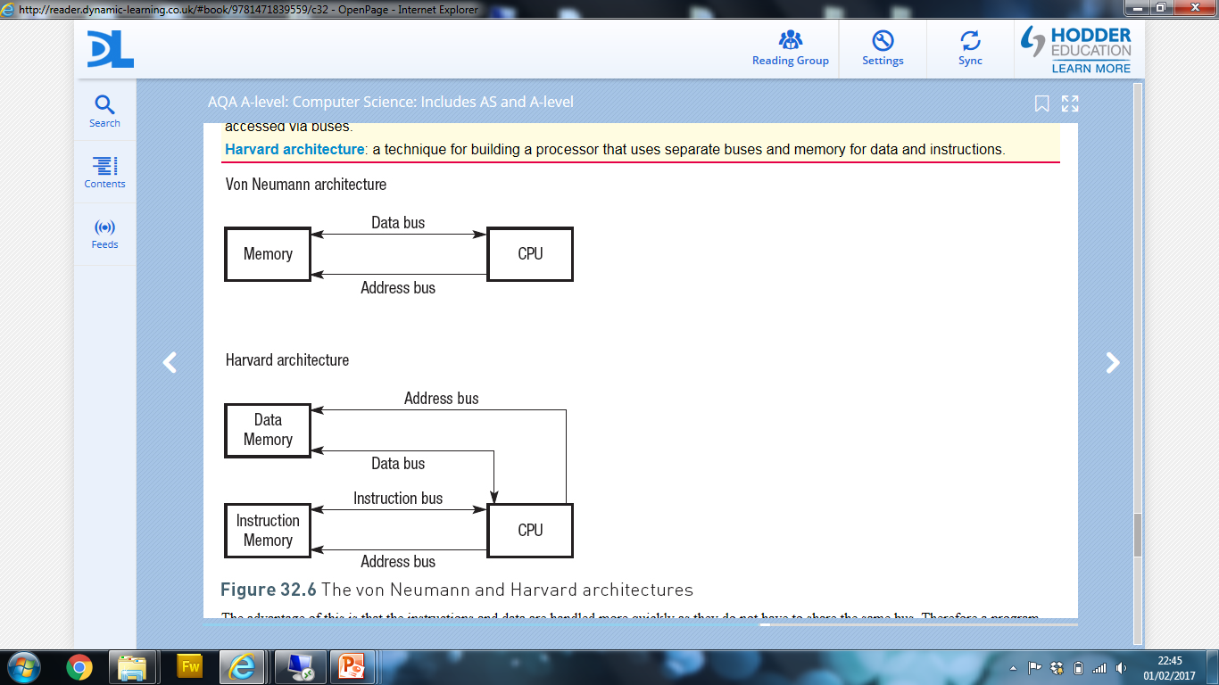
The Fetch-Execute Cycle
LO:
Von Neumann architecture
A microprocessor has an architecture that refers to the way that the chip is built. The von Neumann method of building computers therefore is often referred to as von Neumann architecture.

Slide 6
The Fetch-Execute Cycle
Von Neumann architecture
The von Neumann architecture is flexible
Instructions and data can occupy the same memory.
This means that you don't have to commit ahead of time as to how you want to split memory between instruction space and data space.

Slide 7
The Fetch-Execute Cycle
LO:
Harvard Architecture
Separate buses are used for data and instructions, both of which address different parts of memory.
There are two separate buses addressing two different memories.

Slide 8
The Fetch-Execute Cycle
LO:
Harvard Architecture
Harvard architecture allows for different storage for instruction and data
If instructions will never change, e.g. in a washing machine you can place this in ROM
RAM (which is more expensive) can be used to store just the data
There is also a reduced chance of errors e.g. data can’t be confused with an instruction and vice-versa
Popular for embedded computer programs

Slide 9
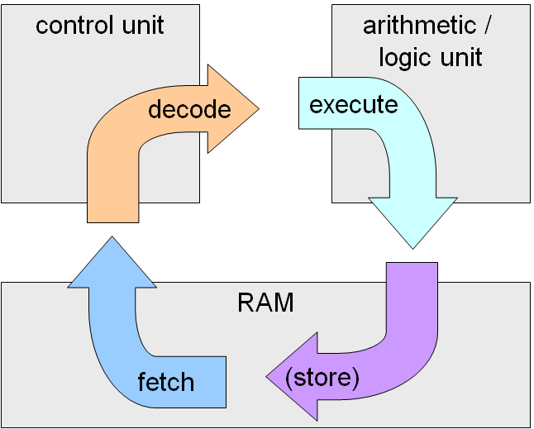
The Fetch-Execute Cycle
LO:
The Fetch-Execute Cycle

Slide 10
The Fetch-Execute Cycle
LO:
The Fetch-Execute Cycle
The von Neumann concept is to store instructions and data in the same memory unit.
Each instruction or data item is fetched from memory, decoded and then executed, with any new data created being placed back into memory.
Every time a program is run, the processor runs through the fetch–execute cycle.

Slide 11
The Fetch-Execute Cycle
LO:
The Fetch-Execute Cycle
Fetch: The processor fetches the program’s next instruction from memory. The instruction will be stored at a memory address and will contain the instruction in binary code.
Decode: The processor works out what the binary code at that address means.
Execute: The processor carries out the instruction, which may involve reading an item of data from memory, performing a calculation or writing data back into memory.

Slide 12
The Fetch-Execute Cycle
LO:
The Control Unit
The control unit is the part of the processor that supervises the fetch–execute cycle.
The control unit also makes sure that all the data that is being processed is routed correctly.
Data is put in the correct register or section of memory.

Slide 13
The Fetch-Execute Cycle
LO:
The Arithmetic and Logic Unit
The ALU carries out two types of operation – arithmetic and logic.
The ALU can be used to carry out common mathematical functions such as add, subtract, multiply and divide, and some other less familiar processes such as shifting.
The ALU is also used to compare two values and decide if one is less than, greater than or the same as another.
The ALU is sent an operation code (op-code) and the operands (the data to be processed).

Slide 14
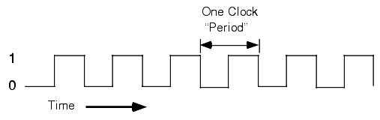
The Fetch-Execute Cycle
LO:
The System Clock and Internal Clock
The system clock is synchronizes components on the motherboard
The CPU clock has the same purpose, but is only used on the chip itself
The CPU needs to perform more operations per time than the motherboard
CPU clock is much faster
The CPU takes the system clock and multiplies it

Slide 15
The Fetch-Execute Cycle
LO:
Interrupts
An interrupt is a signal sent to the processor by a program or an external source such as a hard disk, printer or keyboard.

Slide 16
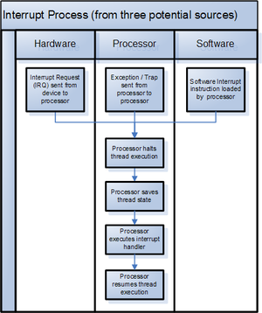
The Fetch-Execute Cycle
LO:
Interrupts
An interrupt is a signal sent to the processor by a program or an external source such as a hard disk, printer or keyboard.

Slide 17
The Fetch-Execute Cycle
LO:
Interrupt Examples
A printer sends a request for more data to be sent to it.
The user presses a key or clicks a mouse button.
An error occurs during the execution of a program, for example, if the program tries to divide by zero or tries to access a file that does not exist.
An item of hardware develops a fault.
The user sends a signal to the computer asking for a program to be terminated.
The power supply detects that the power is about to go off.
The operating system wants to pass control to another user in a multitasking environment.

Slide 18
The Fetch-Execute Cycle
LO:
Handling Interrupts
If an interrupt has occurred the processor will stop whatever it is doing in order to service the interrupt.
It does this using the Interrupt Service Routine (ISR) which calls the routine required to handle the interrupt.
Most interrupts are only temporary so the processor needs to be able to put aside the current task before it can start on the interrupt.
It does this by placing the contents of the registers, such as the PC and CIR, on to the system stack.
Once the interrupt has been processed the CPU will retrieve the values from the stack, put them back in the appropriate registers and carry on.

Slide 19
The Fetch-Execute Cycle
What is a Stack?
A stack is type of memory store
Uses Last in First Out access (LIFO)
01011111
11010101
01111111
01110101
01011101
Into the register
= PUSH
01010111
Out of the register
= POP
01010101
Stack

Slide 20
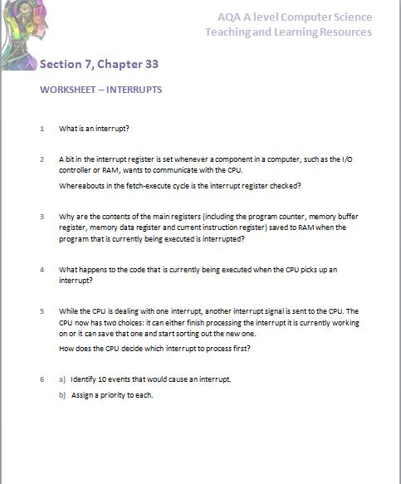
The Fetch-Execute Cycle

Slide 21












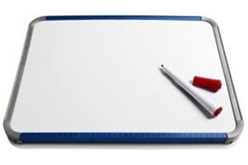


Key words:
Noted clearly
Topic specific vocabulary wherever necessary
Icon for extension activity if appropriate
Icon same colour as dept ex book
You might want to develop subject specific icons

